Slide 1





SENTIMENT ANALYSIS
OF PRODUCT REVIEWS

Slide 2
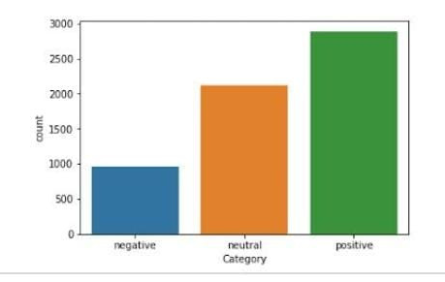
INTRODUCTION
sentiment analysis is defined as process of minning of data,veiw, review,or sentence to predict the emotion of the sentence through NLP.
Sentiment analysis involves classification into three phases positive, negative and neutral.

Slide 3
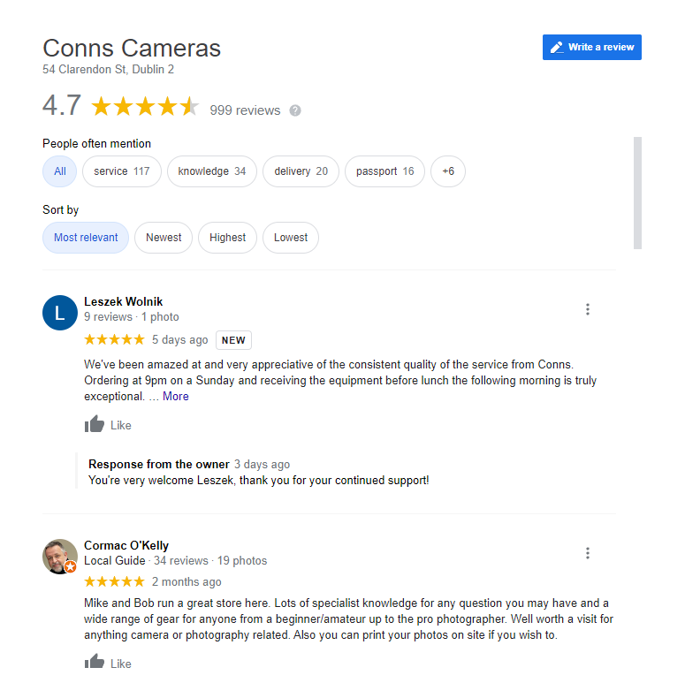
Everyday we come across various products in digital media across hundreds of product choices under one category and it becomes difficult to select one from them
Ratings can be easily sorted and judged whether a product is good or bad
It is quite hard for a human to go through each single line and identify the emotions being a user experience
In AI era it got easy with NLP (Natural Language Processing) technology.

Slide 4

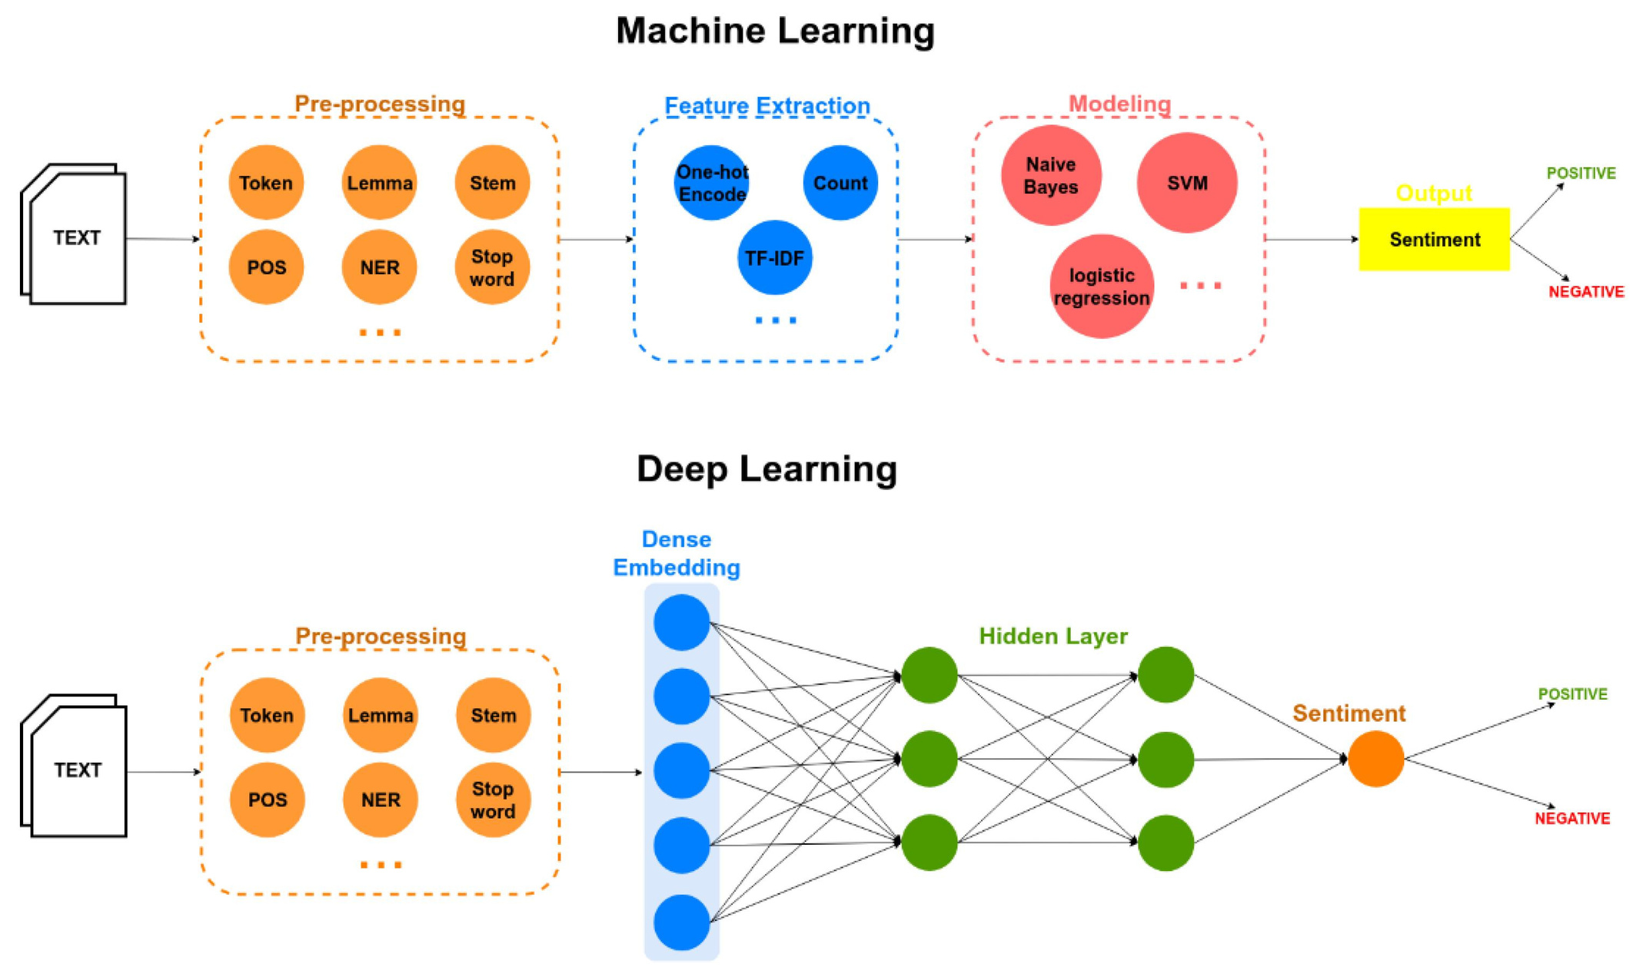

Slide 5
AIMS & OBJECTIVES
To automate the process of gathering online, end users reviews for a given product or services and analyzing those reviews in terms of sentiments expressed about specific features in E-Commerce websites.
Reviews Preprocessing and Cleaning
Story Generation and Visualization from reviews
Extracting Features from Cleaned reviews.
Model Building: Sentiment Analysis

Slide 6

PROBLEM STATEMENT
Web portals get vast amount of feedbacks from customers.
This can be utilized for feedback management system
we classify individual comments or reviews and determine overall rating
The company get complete idea on feedbacks provided by the customers and take care on particular fields.

Slide 7
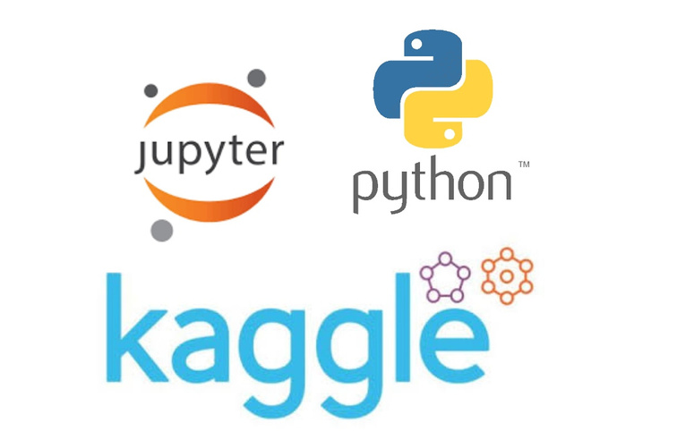
SOFTWARE REQUIREMENTS
The Functional requirements and implementation constrains gives the general overview of the project
Python IDE 3.11.0
jupyter notebook
dataset: Sentimental Analysis of product reviews (Kaggle)

Slide 8

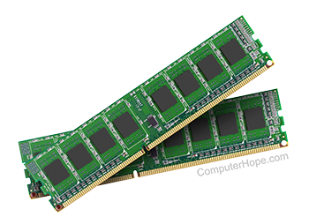
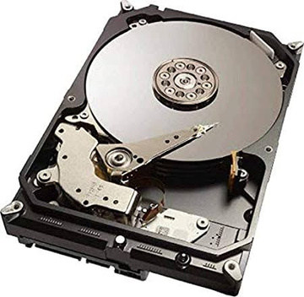
HARDWARE REQUIREMENTS
Applications that need to store large arrays/objects in memory will require more RAM
Operating systems: Windows
Processor: minimum Intel i3
RAM: minimum 4gb
Hard disk: minimum 250gb

Slide 9



METHODOLOGY
Data collection
Data preprocessing
Data resampling
Word vectorization
Classification model

Slide 10

DATA COLLECTION
We collect data from consumer reviews of amazon products .
The data set contain 10,261 data points in total, includes type, name of the product, review and rating of the product.
.
Rating and review plays an essential role in analysis.
Some of the data points have null values, after eliminating we have 10,227 data points in total.
To get an overview we have plotted distrubutions and given a five class rating

Slide 11
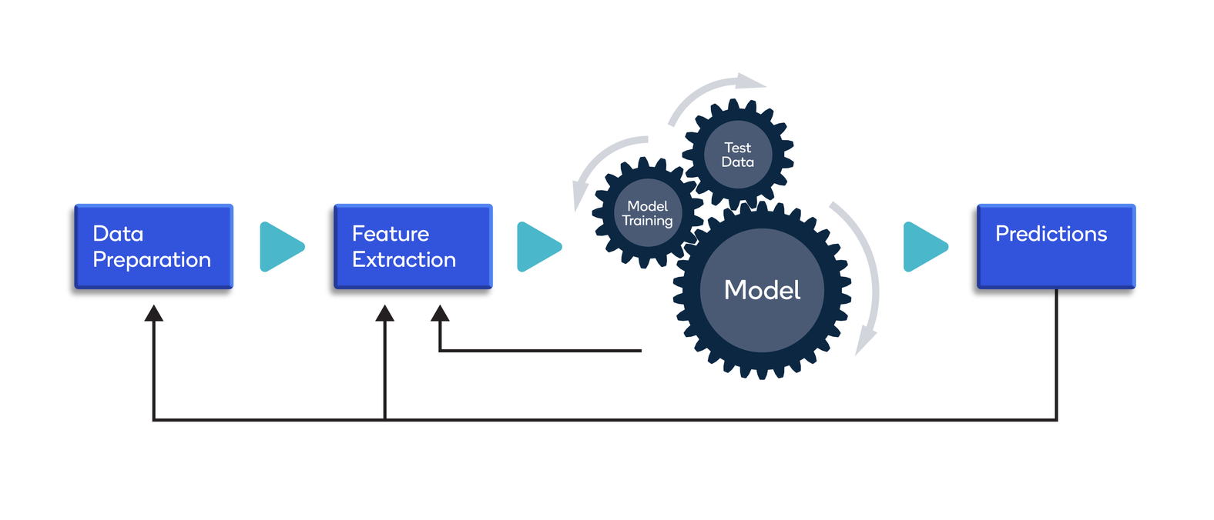


null values
10,261 data points
10,227 data points

Slide 12

DATA PREPROCESSING
Data preprocessing is the process of transforming raw data in to an understable format. The major tasks in data preprocessing are Data cleaning, Data Integration, Data Reduction, Data Transforming.
DATA CLEANING:
It is the process to remove incorrect data, inaccurate data and incomplete data.
Methods used in Data Cleaning is Bining, Handling Missing Values, Noisy, Regression, Clustering.
DATA INTEGRATION:
It is the process of combining multiple sources in to a single data set. The major problmes considered during this process is Schema Integration, Entity Identification Problem, Detecting & resolving data value concepts.

Slide 13
DATA PREPROCESSING
DATA REDUCTION:
This process reduces the volume of the data which makes analysis easier and gives the same or almost same result. Reduction also reduces the storage space. The major technics used in this reduction is Dimensionality Reducation, Numerosity Reduction and Data Compression.
DATA TRANSFORMATION:
The change made in the format or structure of the data is known as data transformation.This step can be complex or simple based on the requirements. The methods used in this transformation is Smoothing, Aggregation, Discretization, Normalization.

Slide 14
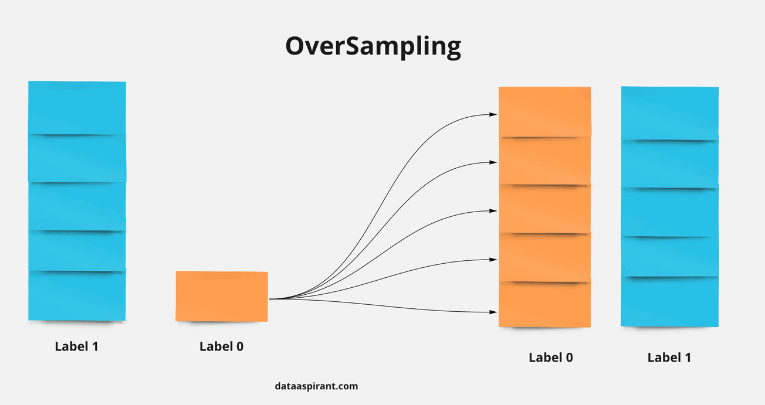
DATA RESAMPLING
Data Resampling is the popular way of dealing imbalanced data
We used SMOTE technique to oversample our data by synthetic approach.
SMOTE:
it is an oversampling technique where the synthetic samples are generated for the minority class. The algorithm helps to overcome the overfitting problem posed by random oversampling. It increases the number of cases in your dataset in a balanced way.

Slide 15

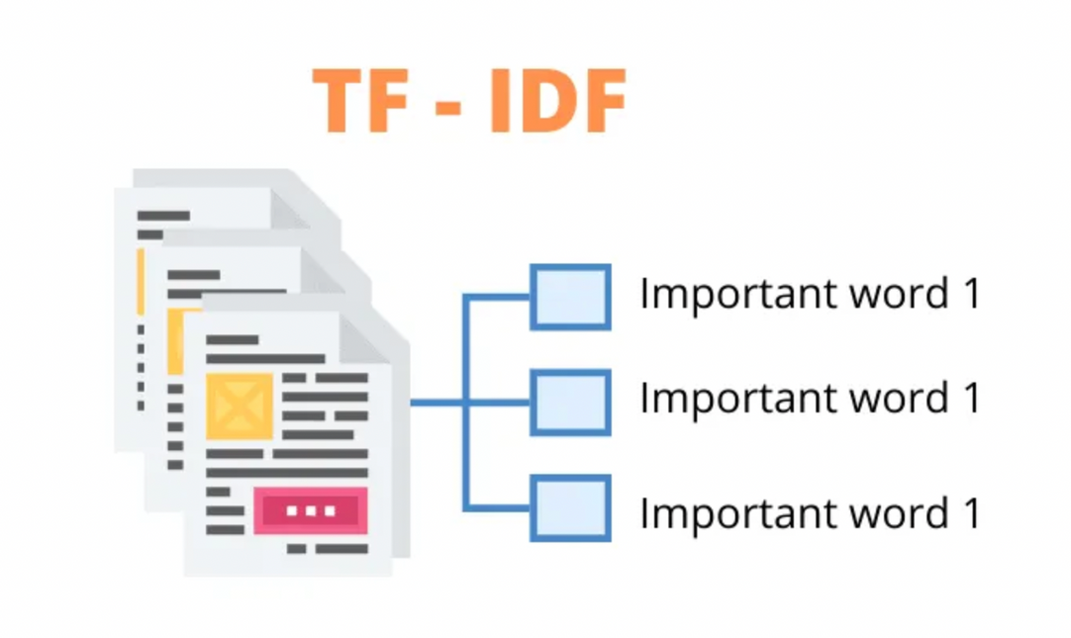
WORD VECTORIZATION
TF-IDF vectorizer:
TF-IDF is a abrevation for Team Frequency Inverse Document Frequency.
This is a very common algorithm to transform a text into a meaningful representation of numbers which is used to fit in machine algorithm for prediction. It transforms text to feature vectors that can be used as input to estimators.

Slide 16
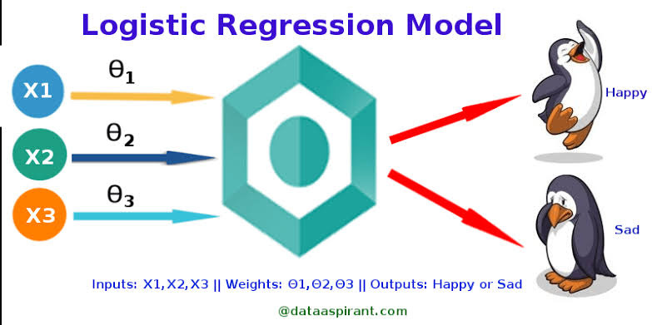
CLASSIFICATION MODEL
LOGISTICS REGRESSION:
Logistic regression is used to solve classification problems, and the most common use case is binary logistic regression, where the outcome is binary (yes or no).
Logistic Regression is a classification algorithm that uses the weighted contribution of the input features and passes through a sigmoid function.

Slide 17
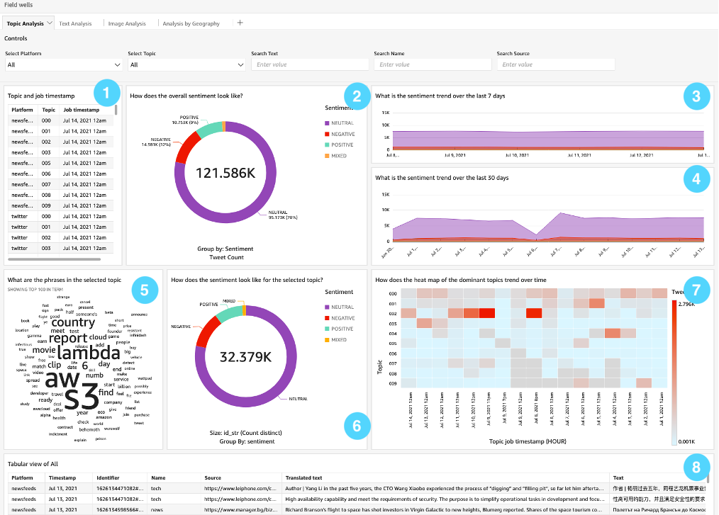

Slide 18

CONCLUSION:
In this research we tried logistic regression to analyze customer feedback and classify all the classes by splitting the sentiments
Our experimental approaches studied the accuracy precision and recall of sentiment classification algorithms
We were able to detect unfair negative, neutral and positive review using detection processes of this method
Most of our neutral reviews for actual critic of product from the buyers, So E-Commerce platforms can consider these as feedback and give them to the seller to help them improve their products.
Balancing the dataset gave us better accuracy score. Without balancing, We got good precision but very bad recall. So balancing is important.

Slide 19


